Slide 1


Buffalo City Metropolitan Municipality
BCMM Climate Change Strategy
Buffalo City Municipality - BCM Thailand Presentation
Trusted custodian of environmental assets
Environmental issues

Slide 2
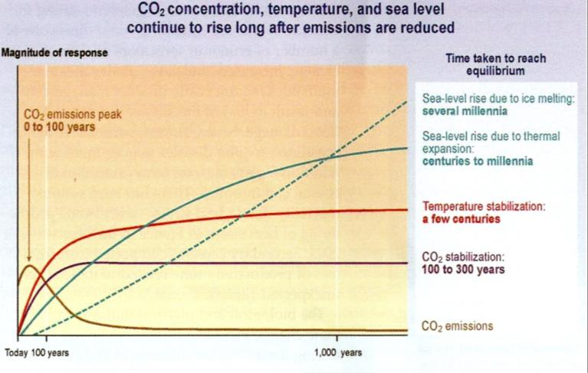
OUR ACTIONS NOW HAVE DRAMATIC FUTURE CONSEQUENCES

Slide 3
CLIMATE CHANGE MANIFESTATIONS IN BCMM
Average monthly temperatures will increase by 1.5 to 2.5 degrees
There will be more extremely hot days and heat waves
Fewer cold/frost days
Increased number of berg wind days
Annual average precipitation will generally increase, BUT, the way in which precipitation occurs will change, namely:
  Increased variability from year to year
  Heavier, more intense rain
  Higher likelihood of destructive storms
  Shorter return period for floods
  Between wet periods, Longer dry spells and increased likelihood/ severity of droughts
Sea level rise coupled with high tides, storm surges and flooding will increase the chances of extreme high-water events, local inundation and coastal erosion.

Slide 4
CLIMATE CHANGE IMPACTS WITHIN BCMM
The climate change impacts within BCMM will be diverse and will have potential impacts on the various sectors and systems relevant to BCMM.
Water resources
Agriculture, rural livelihoods and food security
  Commercial livestock and crops
  Subsistence farming
Human health
Disasters
Terrestrial biodiversity
Marine biodiversity and fisheries
Human society, livelihoods and services
  Urban areas
  Rural areas
  Coastal areas
Municipal infrastructure

Slide 5
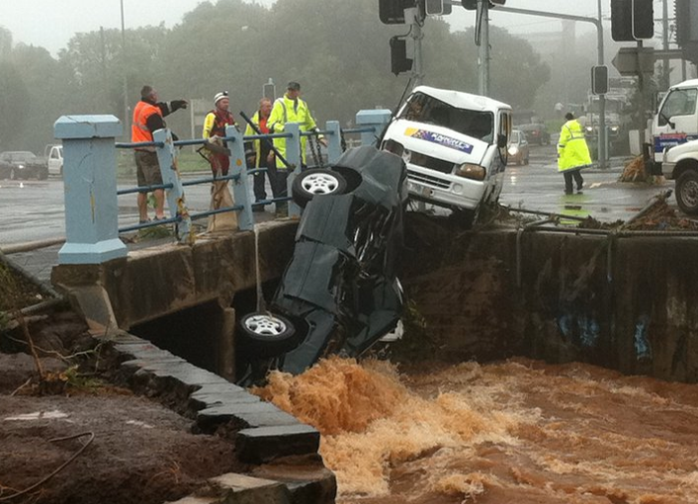
ADAPTATION

Slide 6
ADAPTATION
Adaptation refers to changing human activities and planning to take climate change into account and minimize the negative impacts it may have on quality of life.
Examples :
Because water availability will decrease we can start using drought resistant crops to reduce crop failure.
Because the intensity and number of storms will increase and sea levels will rise, we can stop building new developments in vulnerable floodplains and coastal areas.
Because health problems like heat stroke and diseases like malaria and cholera are predicted to become more prevalent, we can prepare hospitals, health care workers, and health education programs to address these problems more effectively.

Slide 7
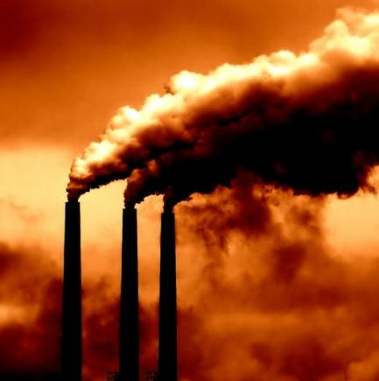
MITIGATION

Slide 8
MITIGATION
Mitigation refers to reducing the amount of GHGs entering the atmosphere from human activities. Mitigation includes actions that:
Reduce GHG emissions by decreasing or eliminating fossil fuel use and other activities that produce GHGs.
Examples:
Increasing the use of more fuel efficient vehicles will reduce the amount of petrol burned in transportation.
Increasing the efficiency of electricity use will decrease the amount of coal burned in electricity production
Preventing loss of ecosystems will prevent carbon stored in vegetation and soils from being released into the atmosphere

Slide 9
Prioritization of Climate CHange risks
Adoption of a systematic climate change risk assessment framework in BCMM planning
Risks
  Nature of risks
  Significance of risks
  Capacity to adapt to risks
  Vulnerability to risks
Key Adaptation Sectors and Response Options
  Water resources
  Agriculture, rural livelihoods and food security
  Biodiversity
  Coastal areas
  Human health
  Municipal infrastructure
  Etc.

Slide 10
Extreme Risks
Primary Impact (Manifestation) | 2nd Order Impact | 3rd Order Impact | Systems/sectors/ Infrastructure | Likelihood | Consequence (Exposure & Sensitivity to Climate Change) | Significance (Likelihood x consequence)
More hot days and heat waves | Increased frequency of fire danger index reaching high-extreme, coupled with berg-wind condtitions | Risk of major loss of livestock, grazing, crops and infrastructure. Threats to financial sustainability of existing commercial and subsistence farming operation and rural livelihoods | Agriculture Sector | Almost certain | Major | Extreme
Increased storm severity | Increased subsidence and loss of coastal land, wetlands and estuaries | Increased damage to/loss of coastal property and infrastructure and increased insurance premiums | Coastal and Marine Systems | Almost certain | Major | Extreme
More hot days and heat waves | Increased frequency of fire danger index reaching high-extreme, coupled with berg-wind condtitions | Risk of major and widespread loss of standing stocks and threats to financial sustainability of existing operations. | Forestry Sector | Almost certain | Major | Extreme
More hot days and heat waves | Increased morbidity and mortality in elderly and infirm (e.g. HIV/AIDS patients) | Increased strain on health services | Social & Economic Systems | Almost certain | Major | Extreme
Higher mean temperatures | Coupled with increased rainfall, spread in range of diseases and vectors, including cholera, malaria and bilharzia. | General increase in occurrence of disease; exacerbation of effects on people with HIV/AIDS, the elderly and the poor. | Social & Economic Systems | Almost certain | Major | Extreme
Increased storm severity | Increased storm surges coupled with sea level rise and flooding from both climate change causes and catchment hardening. | Direct threat to livelihoods, services and infrastructure in coastal low lying areas. | Social & Economic Systems | Almost certain | Major | Extreme

Slide 11
BCMM Climate CHange RISK MATRIX

Slide 12
BCMM IDP & Sector Plan Assessment
BCMM IDP and Sector Plans that have been reviewed to date are given below:
IDP Review 2013/2014
Air Quality Management Plan (2011)
Built Environment Performance Plan (2013)
Comprehensive Integrated Transport Plan - 2008 To 2013 (2008)
Conservation Plan and Municipal Open Space System (MOSS)(2008)
Disaster Management Policy (2011)
Local Economic Development Strategy (2008)
Electrical Master Plan (2010)
Housing Sector Plan 2008-2012 (2008)
Integrated Coastal Zone Management Plan (2007)
Integrated Environmental Management Plan (2007)
Integrated Sustainable Human Settlements Plan (20XX)
Integrated Waste Management Plan (20XX)
Municipal Health Services: Service Delivery Plan (2013)
Municipal Open Space System (MOSS) Extension (2011)
Spatial Development Framework Review (2014) (draft)
State of Energy Report (2008)
Water Services Development Plan (2002)

Slide 13
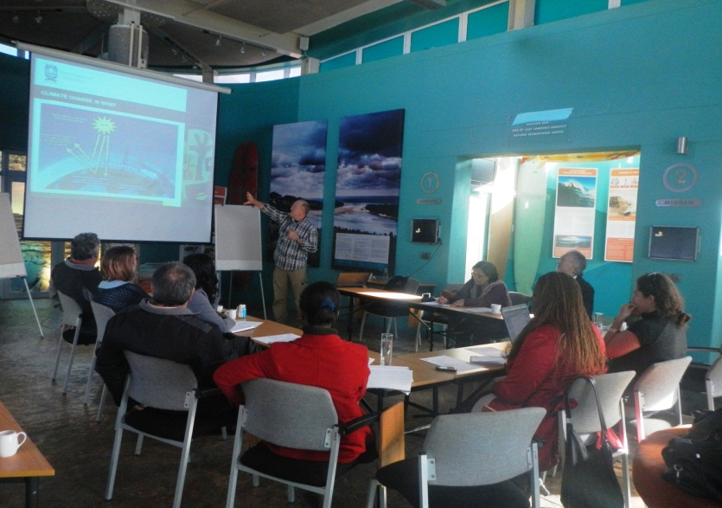
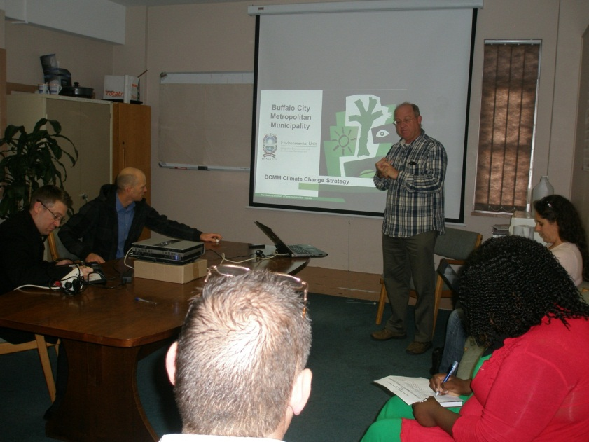
BCMM WORKSHOPS
2 workshops were held with various BCMM departments representing various IDP Sector plans,
Amenities – coastal management
Disaster management
Environmental health
Environmental pollution
GIS
Housing
IEMP
Spatial planning
Transport planning
Waste management
The following are some of the risks, and response opportunities (mitigation and adaptation) that were identified.

Slide 14
OUTCOME OF RISK ASSESSMENT
Based on outcomes of risk assessment and ranking:
  Affected departments and programmes identified;
  Response options identified;
  Response programmes for Extreme Impacts Developed.

Slide 15
RISKS OF EXTREME SIGNIFICANCE
Water
Increased variability and intensity of stormflow and dry spells/droughts
Increased cost of water services e.g. 10% decline in run-off could double the cost of new water schemes
Human health
Increased number of days above 32°C and heat waves exacerbate the effects on the old, and those with HIV/AIDS, TB and other diseases.
Direct threat to human life associated with extreme weather events including storms and floods and storm surges; extremely hot days and heat waves
Urban: Human society, livelihoods & services
Increased exposure of settlements located in flood and inundation-prone areas.
Increased risk of shack-fires.

Slide 16
RISKS OF EXTREME SIGNIFICANCE
Rural: Human society, livelihoods and & services
Increased risk of failure of rain-fed/subsistence crops and associated risk to food security.
Increased stress to rural communities without water services - droughts and contamination of potable water during floods.
Coastal: Humans society, livelihoods & services
Loss of coastal infrastructure and coastal ecosystems from increased coastal erosion and inundation from sea level rise, storm surges, flooding events.
Threats to low lying coastal settlements from coastal inundation
Increased frequency and intensity of coastal storms and associated impacts.
Municipal Infrastructure
Threat of extreme weather to municipal infrastructure, including intense storms and floods, coastal inundation from storm-surge and sea-level rise, droughts, and increased frequency of hot to extremely hot days and associated fires.

Slide 17
RISKS OF HIGH SIGNIFICANCE
Water
Reduced predictability of weather, more intense floods and increased return period for flooding
Agriculture and food security
Reduced availability of irrigation water
Increased risk of reduced yield and failure of rainfed/subsistence crops
Increased pest and disease infestations
Thermal stress - livestock and crops
Human health
Increased range of vector borne diseases (malaria, tick borne diseases) and others such as cholera

Slide 18
RISKS OF HIGH SIGNIFICANCE
Disaster management
Increased incidence of intense storm, flooding, droughts, house and wildfires, coastal inundation, and extremely hot days.
Urban: Human society, livelihoods & services
Increased likelihood of flash flooding in areas with poor stormwater systems and significant catchment hardening
Increased stress to the urban poor - access to infrastructure, heat stress, storm damage, air pollution, exposure to disease.
Increased demand for water services. Reduced availability of water. Increased stresses to water supply systems. Possibility complete depletion of water supply system

Slide 19
  KEY ADAPTATION AND MITIGATION RESPONSES
Adaptation | Mitigation
Air quality
Effective implementation of the BCMM AQMP Promote the use of cleaner energy when assessing AEL applications. Pursue use of cleaner transport fuels Explore possible vehicle inspection and maintenance mechanisms to reduce engine emissions Develop an air quality warning system | Explore promoting low carbon development through exercising authority in emissions licensing Develop an emissions data bank for monitoring and evaluation of local emissions.

Slide 20
  KEY ADAPTATION AND MITIGATION RESPONSES
Adaptation | Mitigation
Transport
Promote road design to consider climate change risks (e.g. flooding and increased precipitation) Adopt more energy efficient modes of transport. Promote public transport (e.g. BRT) | Establish an efficient public transport system (a system that is fast, frequent, reliable, safe and accessible) and moving to cleaner alternatives fuels Promote bio-fuels and biogas as an alternative source of transport fuel Promote compact communities that result in shorter transport routes and reduces the need for multiple and long trips Promote non-motorised transport (bicycles, foot, etc.) Implement focused behaviour change programmes

Slide 21
  KEY ADAPTATION AND MITIGATION RESPONSES
Adaptation | Mitigation
Biodiversity
Implement recommendations of the Conservation Plan and MOSS that promote conservation of open space. Promote the establishment of conservation as refuges for biodiversity under changing climatic conditions. Promote the conservation of indigenous biodiversity that acts as a buffer against severe climatic events, such as flooding. Maintain integrity of MOSS areas, particularly along water courses and along the coastline. | Promote establishment of conservation areas to act as carbon sinks. Promote urban greening programmes with indigenous species, particularly in low income areas. Identify areas suitable for forest or thicket rehabilitation Initiate alien species biomass to energy project.

Slide 22
  KEY ADAPTATION AND MITIGATION RESPONSES
Adaptation | Mitigation
Disasters
Assess climate change risk and vulnerability and incorporate into DMS Source resources for increasing costs of emergency planning and services resulting from climate change Establish an early warning systems Consider changes to zoning and building standards to avoid disaster, notably flood-proof buildings in vulnerable locations Promote the construction of physical barriers and drainage channels in areas vulnerable to flash-flooding Increase fire fighting capacity and early warning systems. Landslides can be curtailed through planting of vegetation cover | NA

Slide 23
  KEY ADAPTATION AND MITIGATION RESPONSES
Adaptation | Mitigation
Economic Development
Promote diverse economy allowing people to protect themselves against adverse shocks and trends. Consider the relocation of buildings located in hazard-prone areas. Businesses that rely on steady water supplies may need to be redesigned as climate change constrains water availability | Promote low carbon emissions green economy, including renewable energy and energy efficiency opportunities Industrial and commercial energy efficiency or demand side management mechanisms

Slide 24
  KEY ADAPTATION AND MITIGATION RESPONSES
Adaptation | Mitigation
Electricity & energy
Ensure electrical infrastructure is resilient to higher temperatures and extreme wind and storm events. Ensure electrical infrastructure is located outside of flood prone areas Social sustainability considerations - all households having access to safe, affordable and reliable energy sources. | Promote energy efficiency or demand side management Develop a programme to steadily reducing dependence on fossil fuels Introduce cleaner fuels such as natural gas into the current fossil fuel mix where feasible Increase BCMM usage of renewable energy (solar, wind, wave, etc.) Promote economic development based on efficient energy resource use

Slide 25
  KEY ADAPTATION AND MITIGATION RESPONSES
Adaptation | Mitigation
Coastal Zone Management
Coastal vulnerability mapping Shoreline management plans More stringent set-back lines Increasing shoreline buffers to protect against increased runoff from more intense storms Researching and monitoring climate change impacts on fisheries Relocating existing development from coastal areas at high risk Prohibiting building in flood-prone areas | Conserve existing and rehabilitate damaged coastal biodiversity as a carbon sink. Investigate wave or ocean current renewable energy

Slide 26
  KEY ADAPTATION AND MITIGATION RESPONSES
Adaptation | Mitigation
Housing & Sustainable Human Settlements
Consider building codes for climate change resilient houses (insulation, storm resilient, energy efficient, etc.) Locate housing in locations less vulnerable to flash flooding Avoid zoning any new housing projects in areas at risk of future sea level rise and coastal flooding Develop an early warning systems for communities in flood or fire risk areas Promote access to safe energy sources to avoid risk of fire from paraffin lamps, candles, etc. Promote conservation of open space areas particularly in flood probe areas | Promote energy efficient homes Develop a BCMM Renewable Energy Policy (e.g. solar geysers, PV, insulation, etc.) Investigate co-funding of renewable energy through carbon credits Locate houses near RE projects (e.g. bio-fuels, solar parks, etc.) Consider commonage areas for RE projects

Slide 27
KEY ADAPTATION AND MITIGATION RESPONSES
Adaptation | Mitigation
Waste management
Promote waste minimization through reduction, re-use and recycling of waste. | Promote the correct disposal waste to improve emissions Consider methane capture from landfill sites and conversion to energy Demand Side Management (DSM) activities and waste recycling to reduce landfill related methane emissions

Slide 28
KEY ADAPTATION AND MITIGATION RESPONSES
Adaptation | Mitigation
Municipal Health
Implement a pollution warning system Ensure an effective emergency response systems Increase support for health facilities A heat alert system warning of heat stress impacting the young and elderly | NA

Slide 29
KEY ADAPTATION AND MITIGATION RESPONSES
Adaptation | Mitigation
Spatial planning
Establish buffer zones prone climate change risks such as flooding and sea level rise Promotion of higher-density and mixed-use forms of development. Retain natural barriers (e.g. coastal dune systems) Demarcate zones of sensitive, vulnerable, highly dynamic and stressed ecosystems in the BCMM area – by ecosystem type (e.g. wetland, dunes etc.) Map high risk areas Identify communities and neighbourhoods that are vulnerable to climate change Don’t approve development in high risk areas | Identify areas where renewable energy resources are located (wind, solar, biomass, land suitable for bio-fuel crops, etc.). Denser settlements reduce emissions from transport.

Slide 30
KEY ADAPTATION AND MITIGATION RESPONSES
Adaptation | Mitigation
Water services
Ensure that the impacts of climate change included in WSDP Locate infrastructure in areas less susceptible to climate change impacts Introduce more energy efficient technologies or strategies Promote water conservation and recycling Improved monitoring and forecasting systems for floods and storms is likely to be more cost effective than paying for the damage from flooding. Design of storm or flood resilient infrastructure and buildings Promote rehabilitation of natural flood barriers, notably wetlands and river courses Implementation of water conservation programmes in anticipation of changing drought frequencies. | Implement more energy efficient technologies Identify and implement technologies that convert waste to energy (e.g. biogas) Energy generation and carbon credits can fund technology Increased water flows in the east may be an opportunity for hydro-power

Slide 31
  INSTITUTIONAL ARRANGEMENTS & KEY RESPONSE FUNCTIONS
IEM&SD Unit - Chief Biodiversity and Climate Change Section Manager.
Other key functions:
  Disaster management
  Health Services
  Engineering (water, sanitation electrical, transport, roads)
  Development planning
  Conservation planning
  Waste management
  LED
Close coordination between the IEM&SD Unit and the above functions in particular.
Develop detailed Climate Change Action Plans (CCAPs) following the broad template provided below:

Slide 32
ADAPTATION & MITIGATION: PROGRAMMATIC APPROACH TO RESPONSES
CLIMATE CHANGE ACTION PLANS
ADAPTATION
Coastal Infrastructure and livelihoods
Water Resource Scarcity Planning
Flood management - Urban communities vulnerable to flooding,
Managing the effects of increased temperature on human settlements
Managing risks to food security Rural livelihoods – failure of rain-fed subsistence crops and water scarcity
MITIGATION
Promotion of renewable energy in BCMM
Mitigation and Opportunities for Sustainable Rural and Urban Settlement.
Mitigation in Solid Waste and Wastewater Treatment

Slide 33
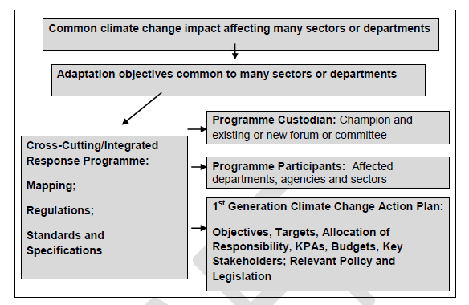
ADAPTATION & MITIGATION: PROGRAMMATIC APPROACH TO RESPONSES

Slide 34
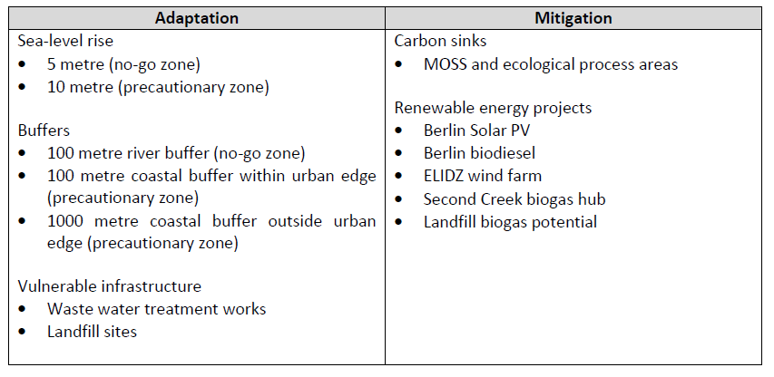
Mapping climate change adaptation and mitigation

Slide 35
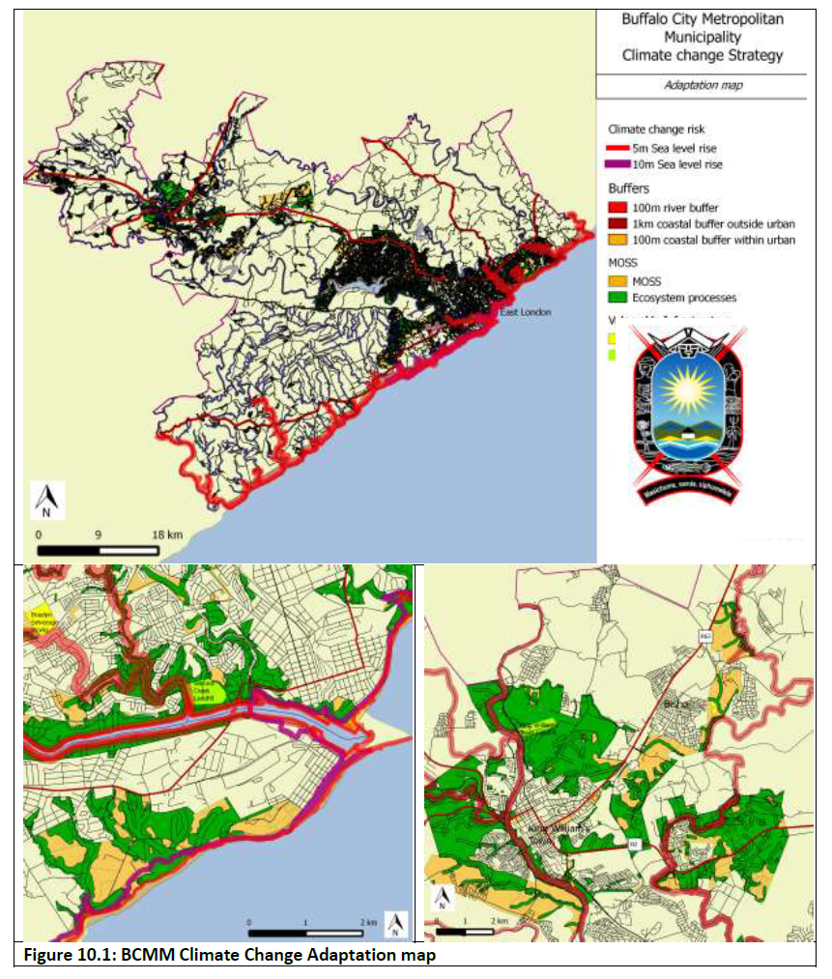

Slide 36
