Slide 1
ArcGIS for Local Authorities
Improving governance processes within regulatory requirements,
whilst increasing revenue
Notes:
Who we are? Esri is the global market leader in GIS and have helped customers improve results since 1969;
The world’s second largest privately owned software house ((SAS (Statistical Analysis Software))) is No. 1;
Esri South Africa has been the primary geospatial industry software provider in Southern Africa for the past 28 years (Established in 1989);
Esri South Africa is a Level 3, 100% BBBEE contributor;
With headquarters in Midrand, Gauteng, Esri South Africa has offices nationwide, enabling the provision of professional, individual client services to our growing user base;
We believe in making a difference by simplifying decisions through spatial solutions, we enable our clients to make responsible and sustainable decisions;

Slide 2
What is AFLA (ArcGIS for Local Authorities)?
AFLA has been developed by Esri South Africa specifically for the South Africa Local Authority market.
AFLA is a workflow based solution that is configured, in conjunction with the Local Authority, to meet the required legislation and municipal by-laws.
AFLA comprises of various modules, namely:
AFLA Portal – Online portal for the submission of applications
TPAMS – Town Planning Application Management System
BPAMS – Building Plan Application Management System
PLAMS – Municipal Property and Lease Management System
WAMS - Wayleaves Application Management System
Billing Viewer – integrates with the Billing System and provides a spatial representation of the status of billing
AFLA is a web based solution that runs on the Esri Platform within the organization

Slide 3
What is AFLA Portal?
External facing web-based online system for the public to submit applications to the municipality
Includes the submission of all types of Applications e.g. Town Planning, Building Plans, Leases and Wayleaves etc.
All applicants register via AFLA Portal and require Municipality approval prior to being permitted to submit an application
Completes the 1st step of the internal workflow of the AFLA Module i.e. the applicant completes this step
Keeps the applicant informed on the progress of the application
Improves citizen engagement
Improves doing business with Municipality

Slide 4
AFLA Portal Registration and Login Page

Slide 5
What is TPAMS (Town Planning Application Management System)?
Web-based system handling all Town Planning applications electronically, moving away from paper-based systems
Built on a workflow that follows the application process of a land use or spatial development application step-by-step
The workflow supports the Spatial Planning and Land Use Management Act (SPLUMA) compliancy and its adaptability caters for each municipality’s bylaws
Electronic management of Town Planning applications means progress can be easily monitored
All documentation linked to applications are stored in a central repository
Standard weekly or monthly reports are generated
Includes a dashboard to easily monitor the status of applications at a property level

Slide 6
Login Page for all AFLA Modules and select the required Module

Slide 7
Select the module you require e.g. BPAMS to load the Application

Slide 8
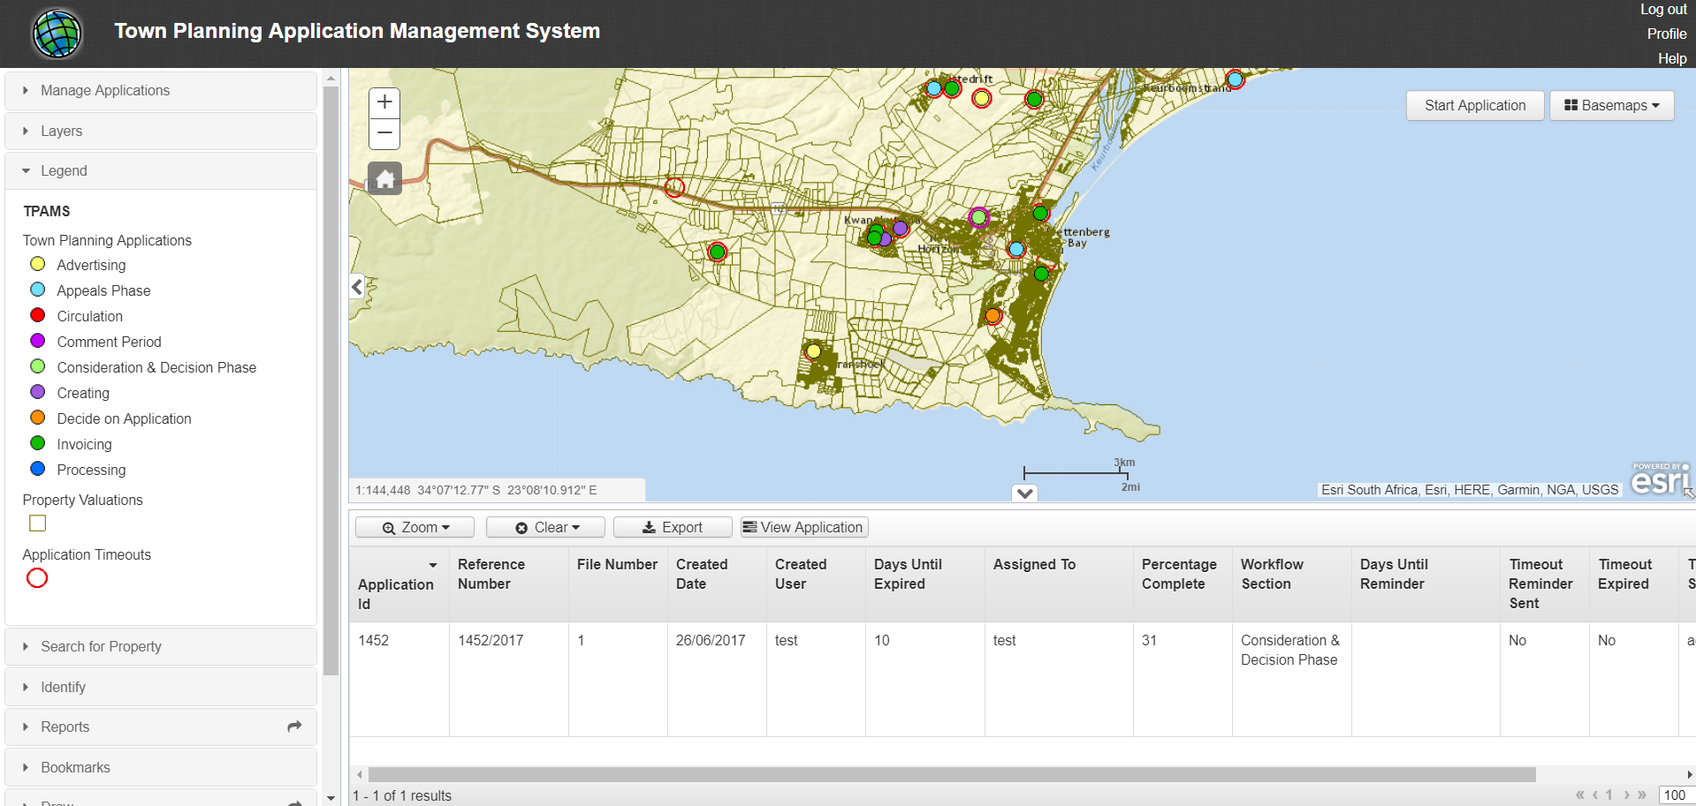
Town Planning Application Management System

Slide 9
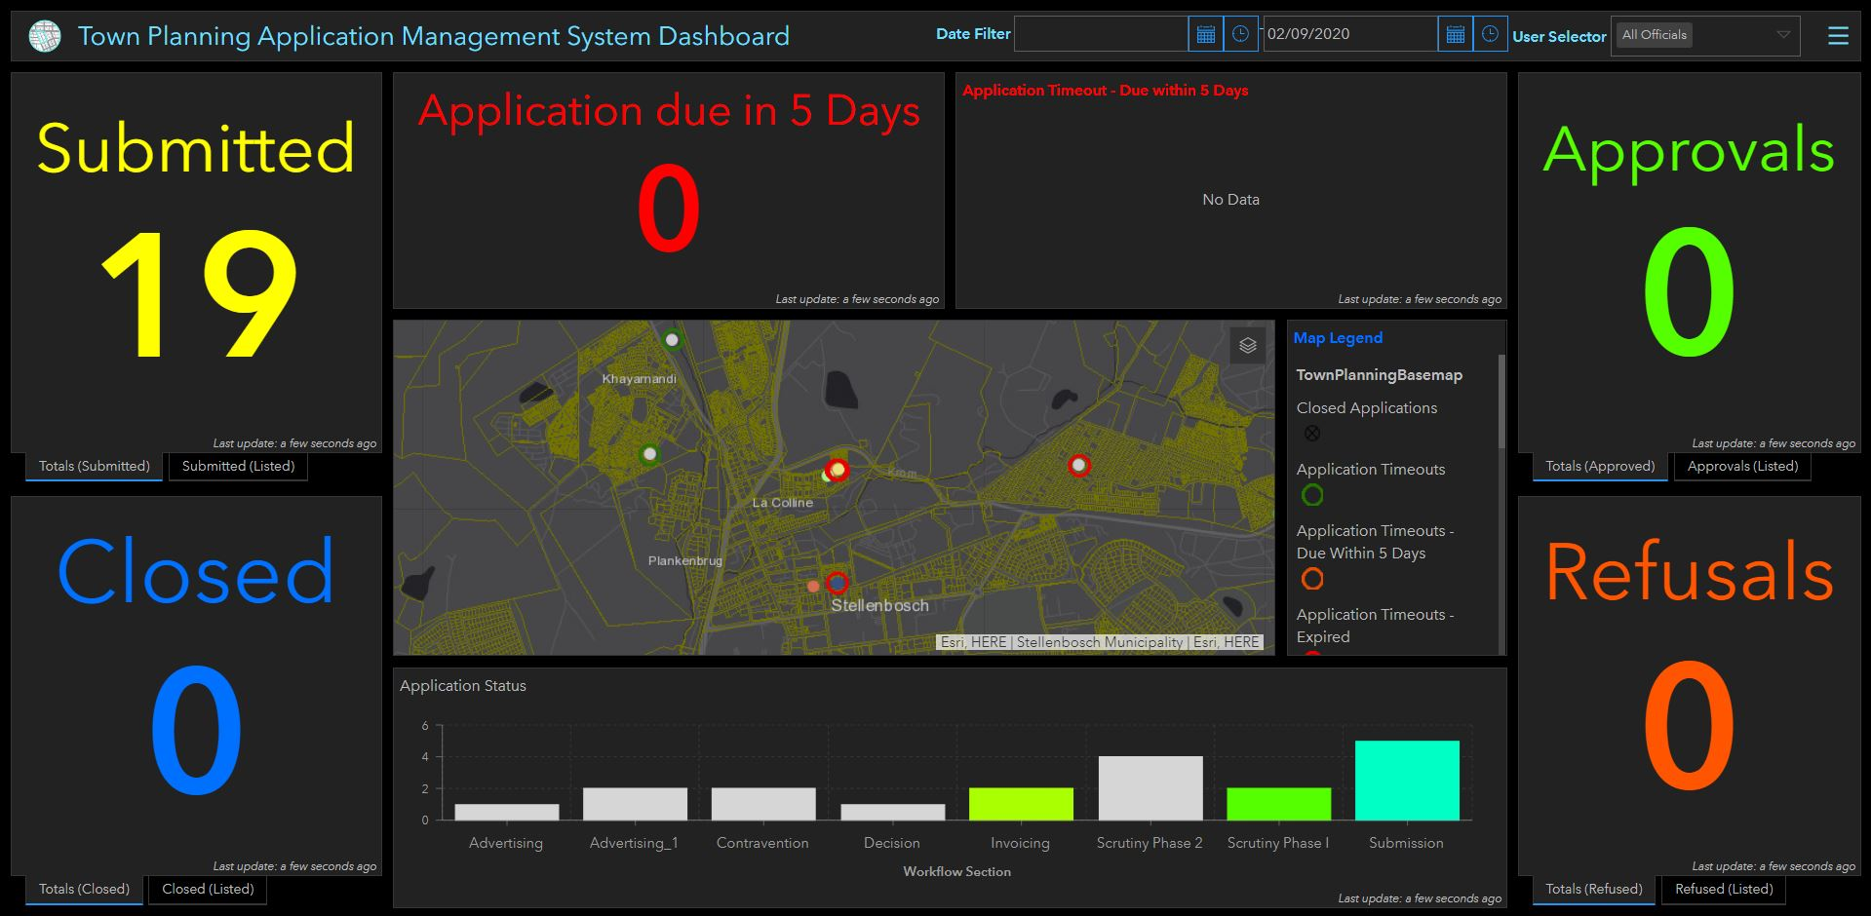
Town Planning Application Dashboard

Slide 10
What is BPAMS (Building Plan Application Management System)?
Enables the electronic monitoring and management of Building Applications
BPAMS follows an application’s progress, step-by-step, using a workflow
The workflow is configurable to align to a municipality’s unique process
All communication and documentation is attached and uploaded on the system
Relevant persons can be contacted and instructed on what tasks need to be carried out, such as inspections and site verification
Includes mobile capabilities for site inspections by building inspectors

Slide 11
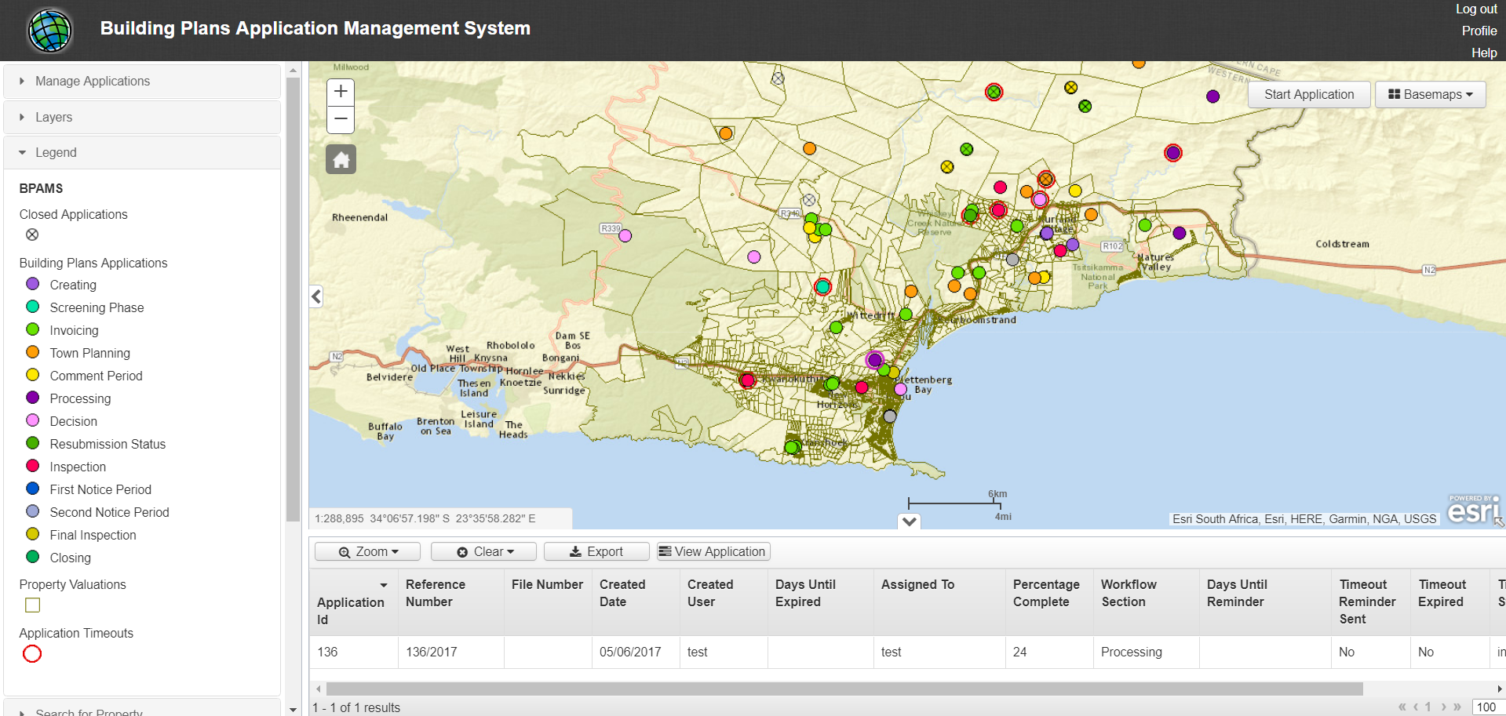
Building Plan Application Management System

Slide 12
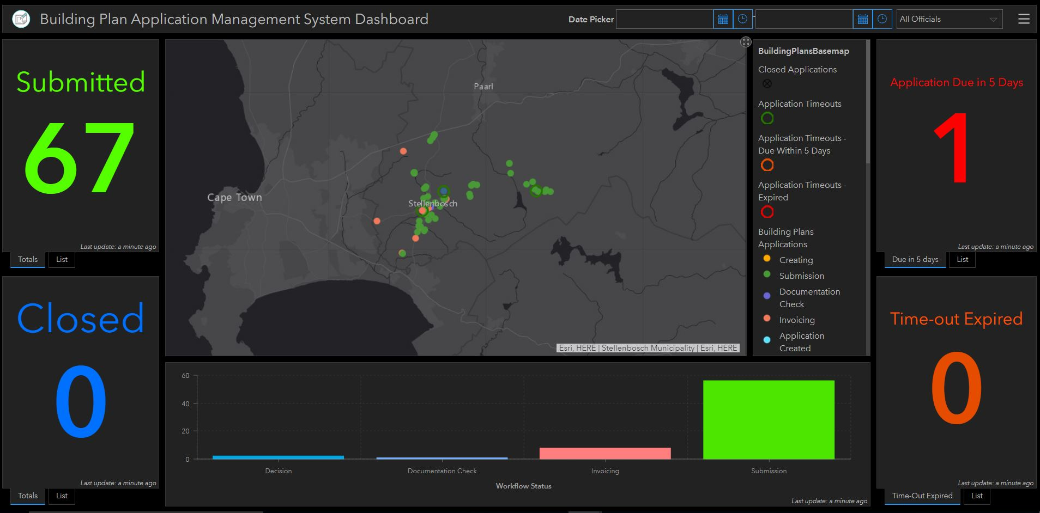
Building Plan Application Dashboard

Slide 13
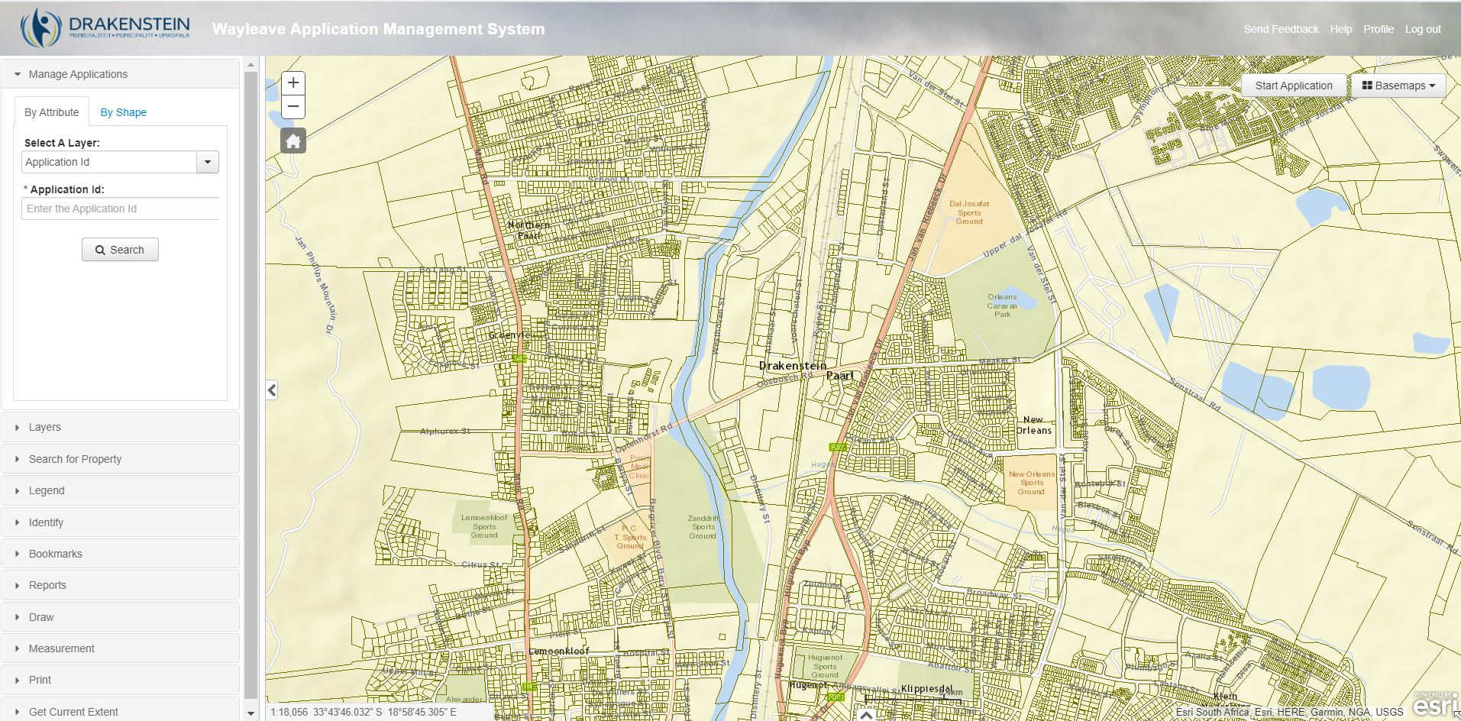
Wayleaves Application Management System

Slide 14
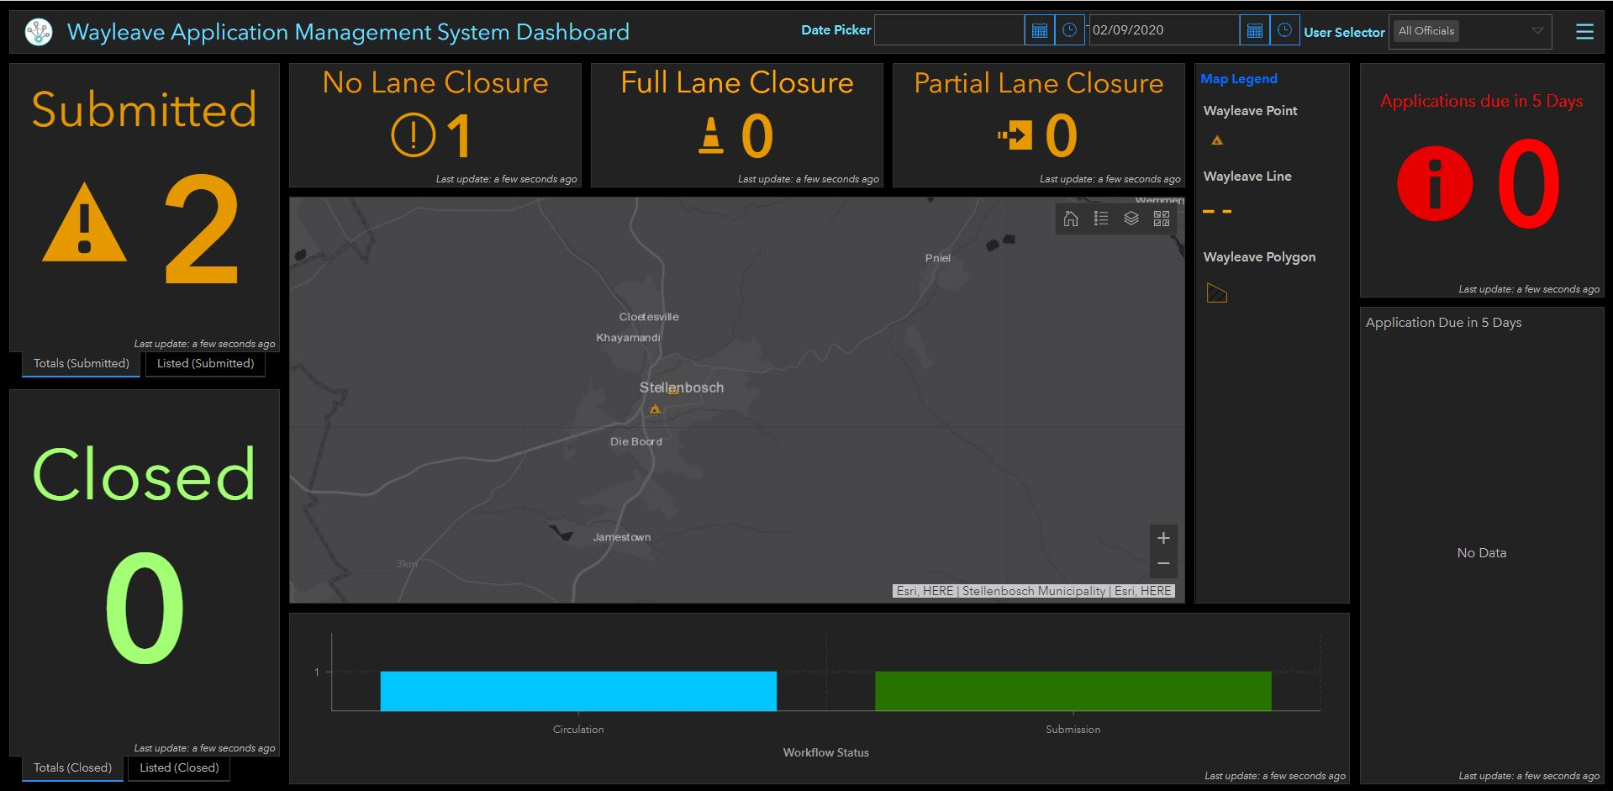
Wayleaves Application Management Dashboard

Slide 15
What is The Billing Viewer?
Provides automated spatial visualisation of financial information within a municipality
Data alignment and transparency are enabled across all management processes
Assists municipalities to ensure that correct billing is taking place by linking accounts to current registered properties
Improved data quality is promoted as account details can be verified against what is on the ground i.e. erf or farm
Municipalities are provided with a spatial view of their aged debtor analysis
Displays information regarding consumption, services (prepaid/ bulk electricity, refuse, sanitation and water), property valuation and municipal-owned land
Displays properties with registered Indigents

Slide 16
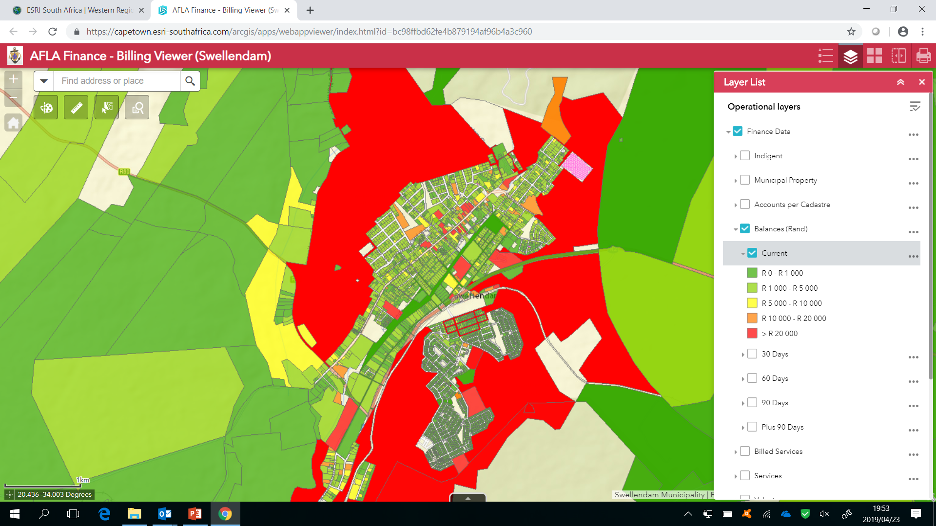
Billing Viewer

Slide 17
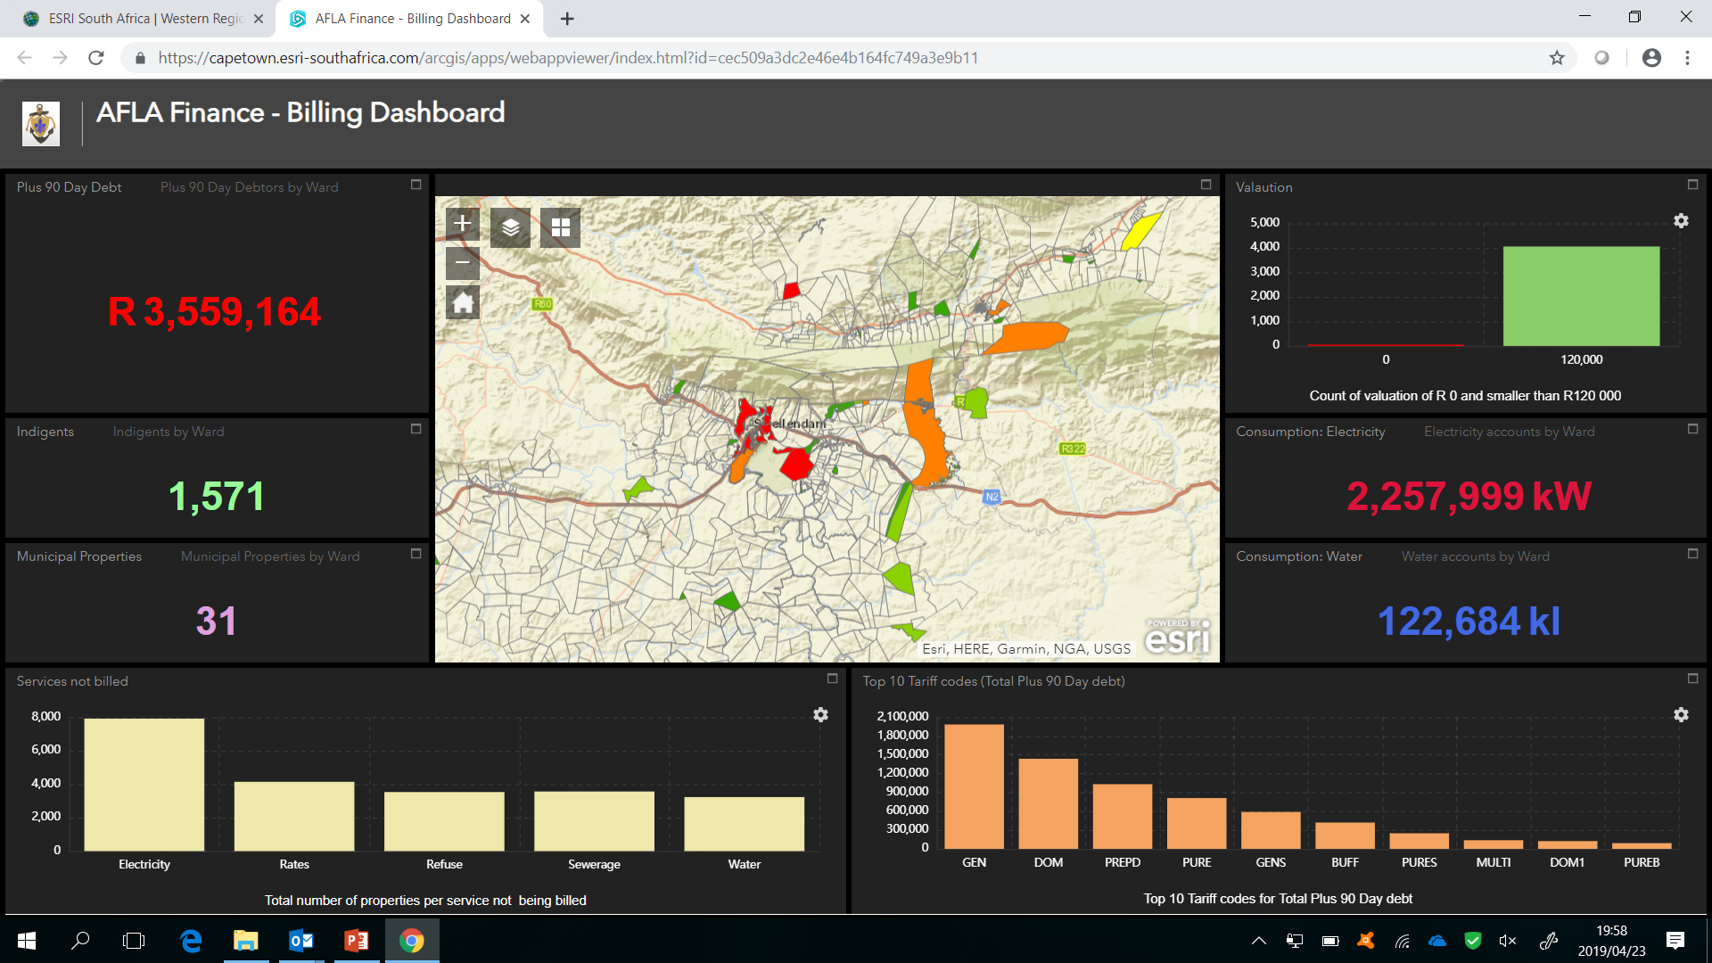
Billing Viewer Dashboard

Slide 18
AFLA Functionality - High Level Overview
Configure the system based on the municipalities requirements i.e. templates, tariffs, vote numbers, letterheads, recipients contact details etc.
Manage Users and Security
Create an Application
Send communication to internal and external stakeholders
Receive communication from internal and external stakeholders
View application details
Search for applications
Generate Reports

Slide 19
Configure the Systems Settings for Each module

Slide 20
Create an Application

Slide 21
Send Communication to Stakeholders

Slide 22
Receive Communication from Stakeholders

Slide 23
Search for an application by Application ID or by Property

Slide 24
View all details relating to an Application

Slide 25
View all details relating to an Application

Slide 26
Thank You

